Slide 1
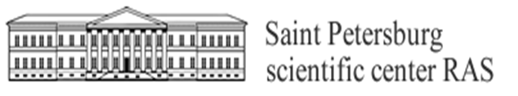

"Кольчатая нерпа, территориальная организация популяции в акватории Финского залива."
"Ringed seal, territorial organization of the population in the waters of the Gulf of Finland."
Mikhail Verevkin¹, Mart Jüssi²
1 Federal State budget Institution St. Petersburg Scientific Center of the Russian Academy of Sciences (SPbRC RAS), Russia
2 Pro Mare MTÜ (non-profit consultancy), Estonia

Slide 2
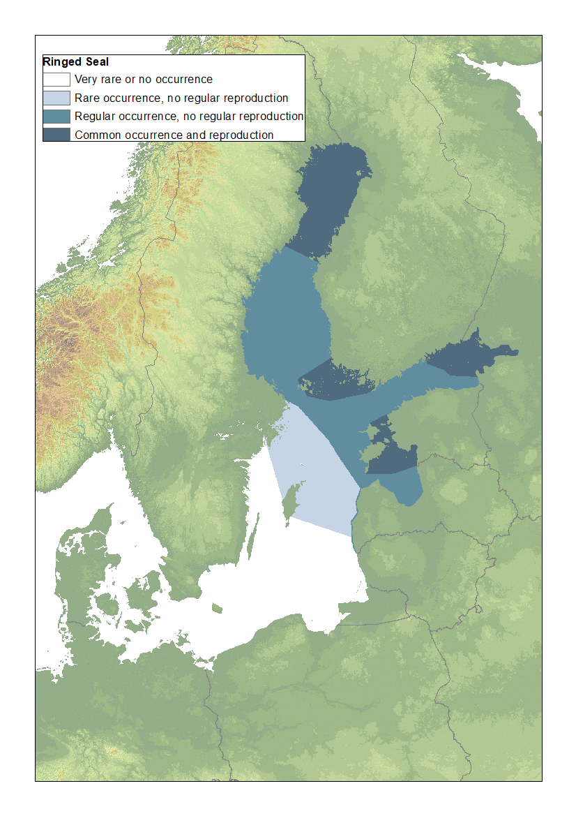
Ringed seal sub-populations and abundance in the Baltic Sea
The Gulf of Bothnia > 10 000, slowly growing, but annual growth rate
stays below the potential for healthy population.
The Archipelago Sea 200-300, data scarce.
The Gulf of Finland (Eastern part): 100+, no trends detectable, critically low population (less than Saimaa seal and Mediterranean monk seal) with high degree of isolation from the other sub-populations.
The Gulf of Riga > 1000, no trends over past 25 years

Slide 3
Results of the ringed seal censuses in the Russian part of the Gulf of Finland in 2010-2021. Standard (HELCOM) method used.
Year | Survey length (km) | Area of survey sq.km | Ice area sq.km | %% of ice surveyed | Ringed seals
 |  |  |  |  | Seen | Absol. num.*
2010 | 347,5 | 278 | 1193 | 23,3 | 6 | 26
2012 | 642,2 | 517 | 3916 | 13,2 | 12 | 90
2017 | 361,2 | 289 | 1640 | 17,7 | 9 | 51
 | 490,2 | 392 | 2451 | 16 | 13 | 81
2018 | 365,9 | 293 | 2081 | 14 | 10 | 71
 | 200 | 160 | 1191 | 13 | 13 | 100 (+13 FIN)
2021 | 216 | 172,8 | 1218 | 14,1 | 19 | 135
 | 273 | 218,5 | 1300 | 16,7 | 16 | 96

Slide 4
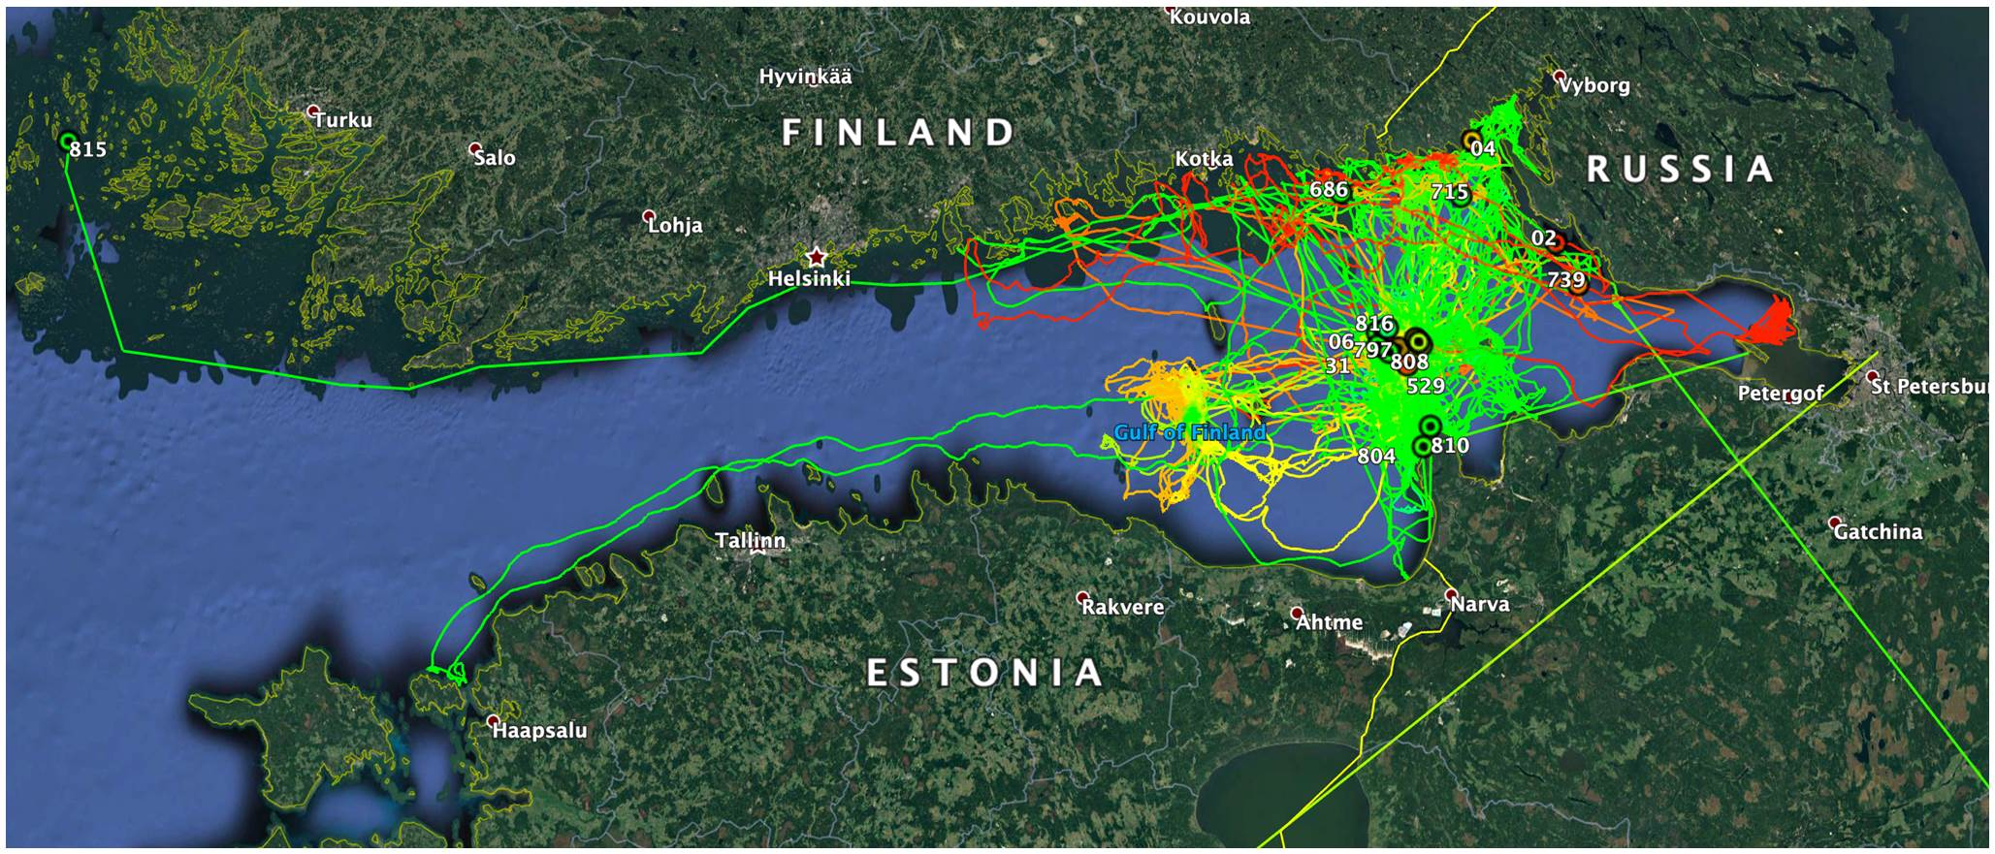
Telemetry data from 23 ringed seals in the Gulf of Finland.
The sample represents approximately 20 % of the population!
240Km
110km

Slide 5
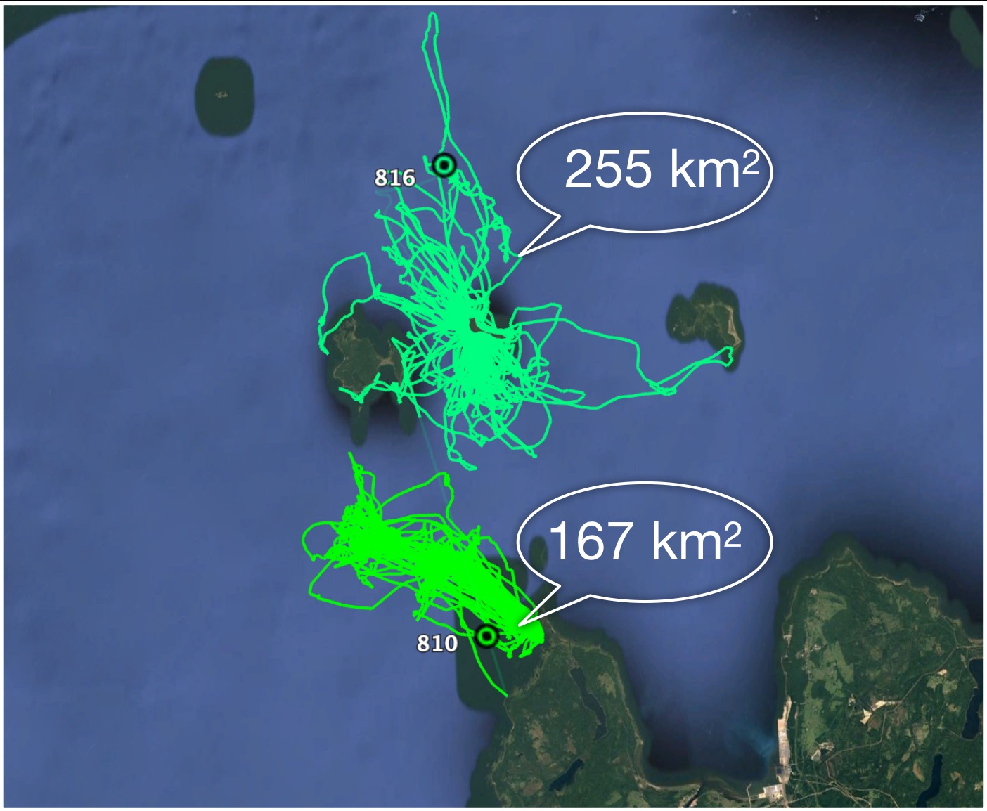
Home ranges of two seals calculated from outermost registered locations on their tracks (September - February).

Slide 6
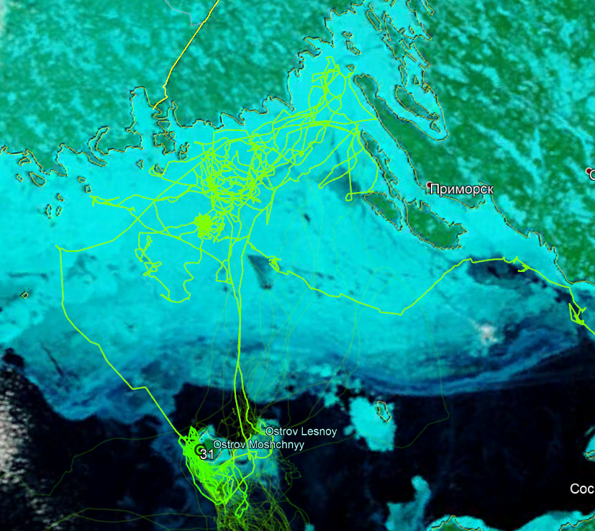
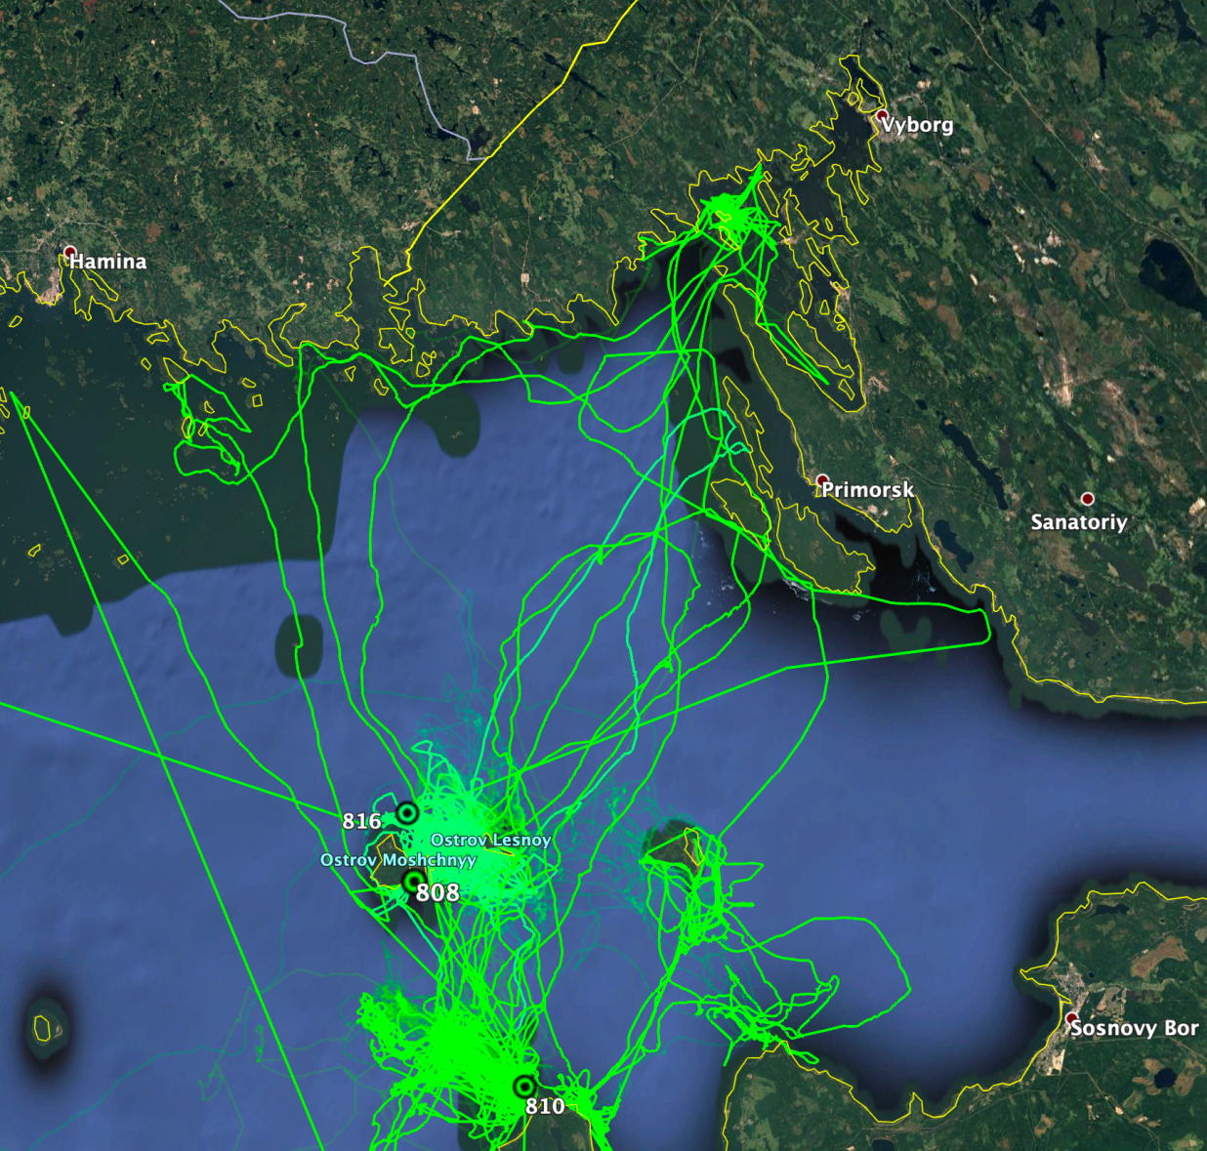
Ringed seal breeding areas and ice free winters
Seal racks Jan- March, 2018
Seal tracks Nov 2019 - Feb, 2020

Slide 7
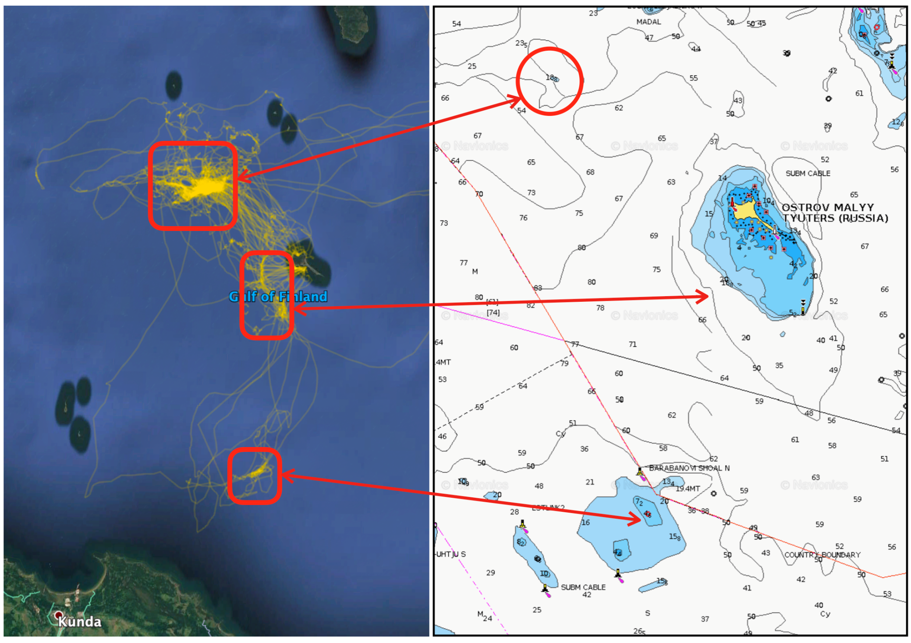
Foraging is related to terrain elements: slopes, channels, shoals

Slide 8
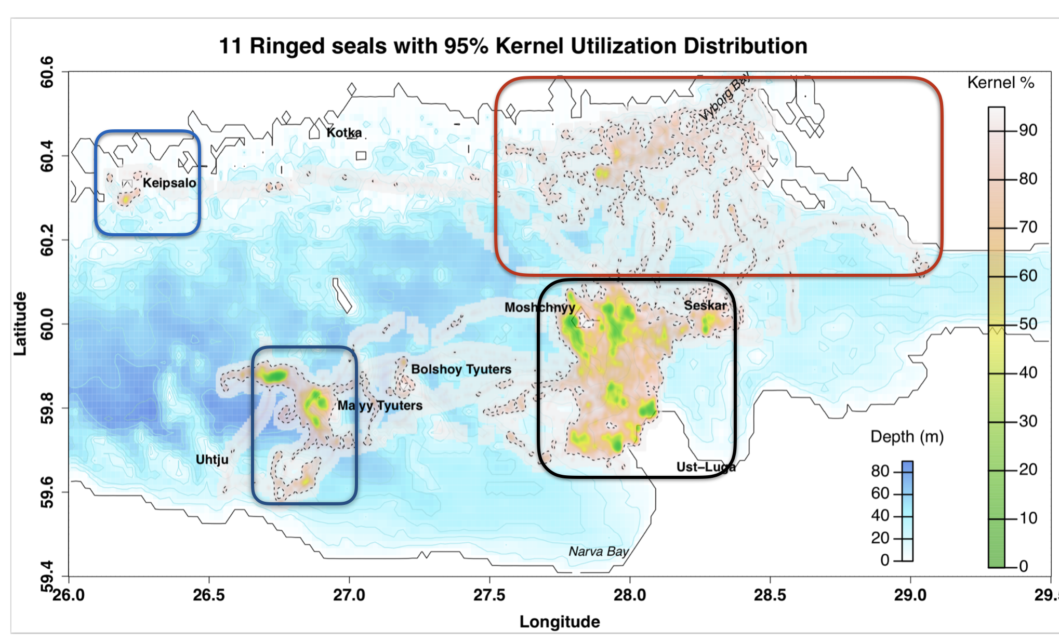
Behaviour allows to detect key habitats
Core distribution area (black), all year, satellite distribution areas (dark blue) summer, reproduction (red), winter if/when the sea freezes.
Truly international species requiring common research and conservation efforts !!!

Slide 9
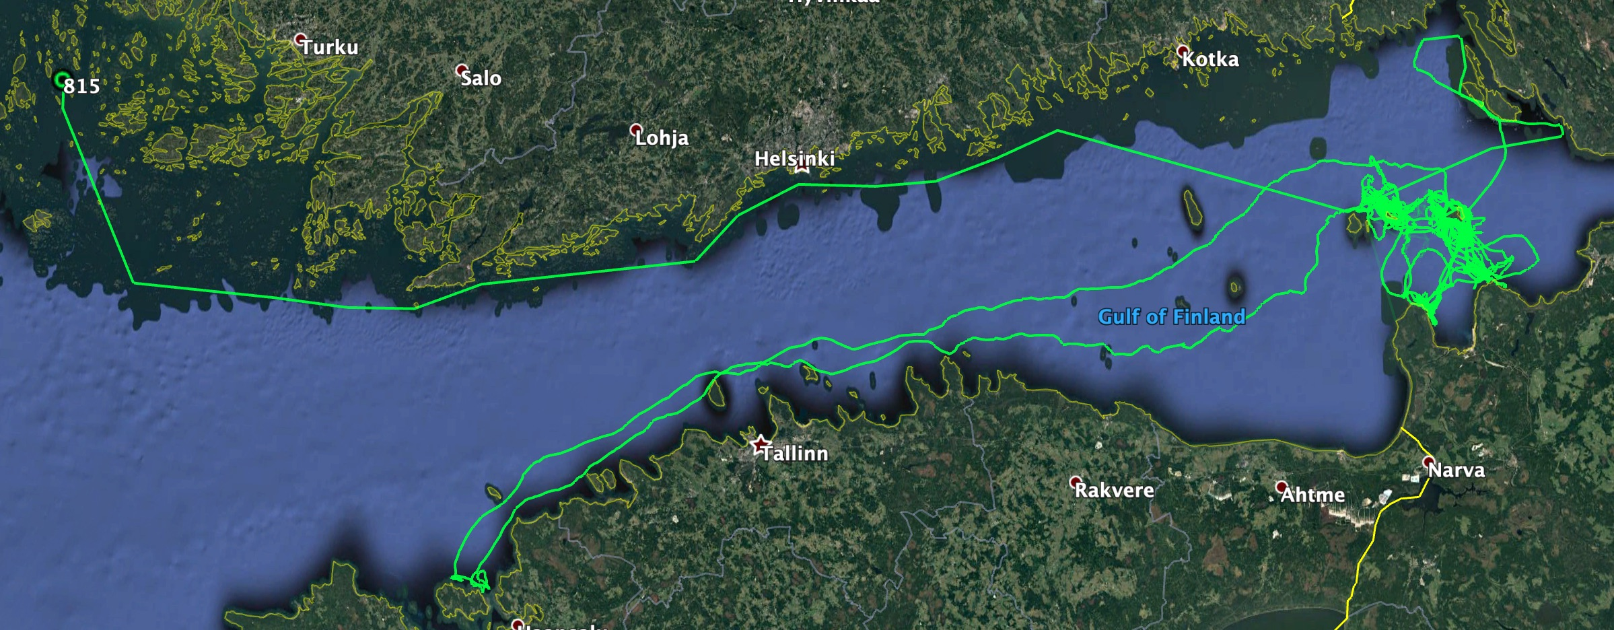
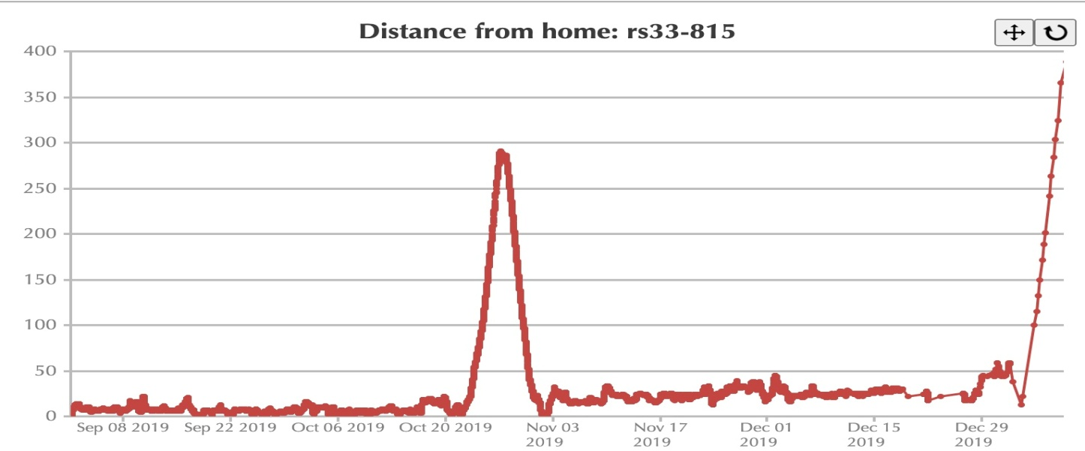
Long range movements of seal rs33-815-18.
330 kilometres from Moshnyi to Vormsi (West Estonia) in just 106 hours and returned covering 345 kilometres in 101 hours.
Gulf of Finland to Åland sea later in the season covering 340 kilometres in 104.5 hours.
Constant average linear movement speed during these transfers 3.23 km/h.

Slide 10
Conclusions
The eastern population of the Baltic ringed seal is inhabit in the eastern part of the Gulf of Finland (east of 260 E.L.).
The ringed seals in the Gulf of Finland are critically low in numbers and isolated to a very high degree. This makes them vulnerable to local extinction. Ringed seal is a serious conservation concern.
The data obtained by telemetry indicate the extreme importance of the Kurgalsky Reef and islands in the southern part of the gulf as the main habitat of the population.
The main foraging areas of tagged seals were confined to the places where the bottom relief changes, mainly to the hollows.
In autumn, when the water cools down, the seal goes to the north in search of ice for breeding.
The key breeding habitats of seals are found in the Eastern part of the gulf and the deteriorating ice conditions are bringing about critical changes in breeding success.
To maintain a good overview of the seals’ status in this semi-closed sea are alternative survey methods are developed for ringed seals in the conditions of warm winters. The methods will be part of the HELCOM monitoring guidelines.
Dense cooperation and international coordination are the preconditions for fruitful work with seals in the Gulf of Finland. Changing environment calls for full attention and involvement of the best available expertise to maintain the unique diversity and ecological balances of the gulf in close and far future.

Slide 11
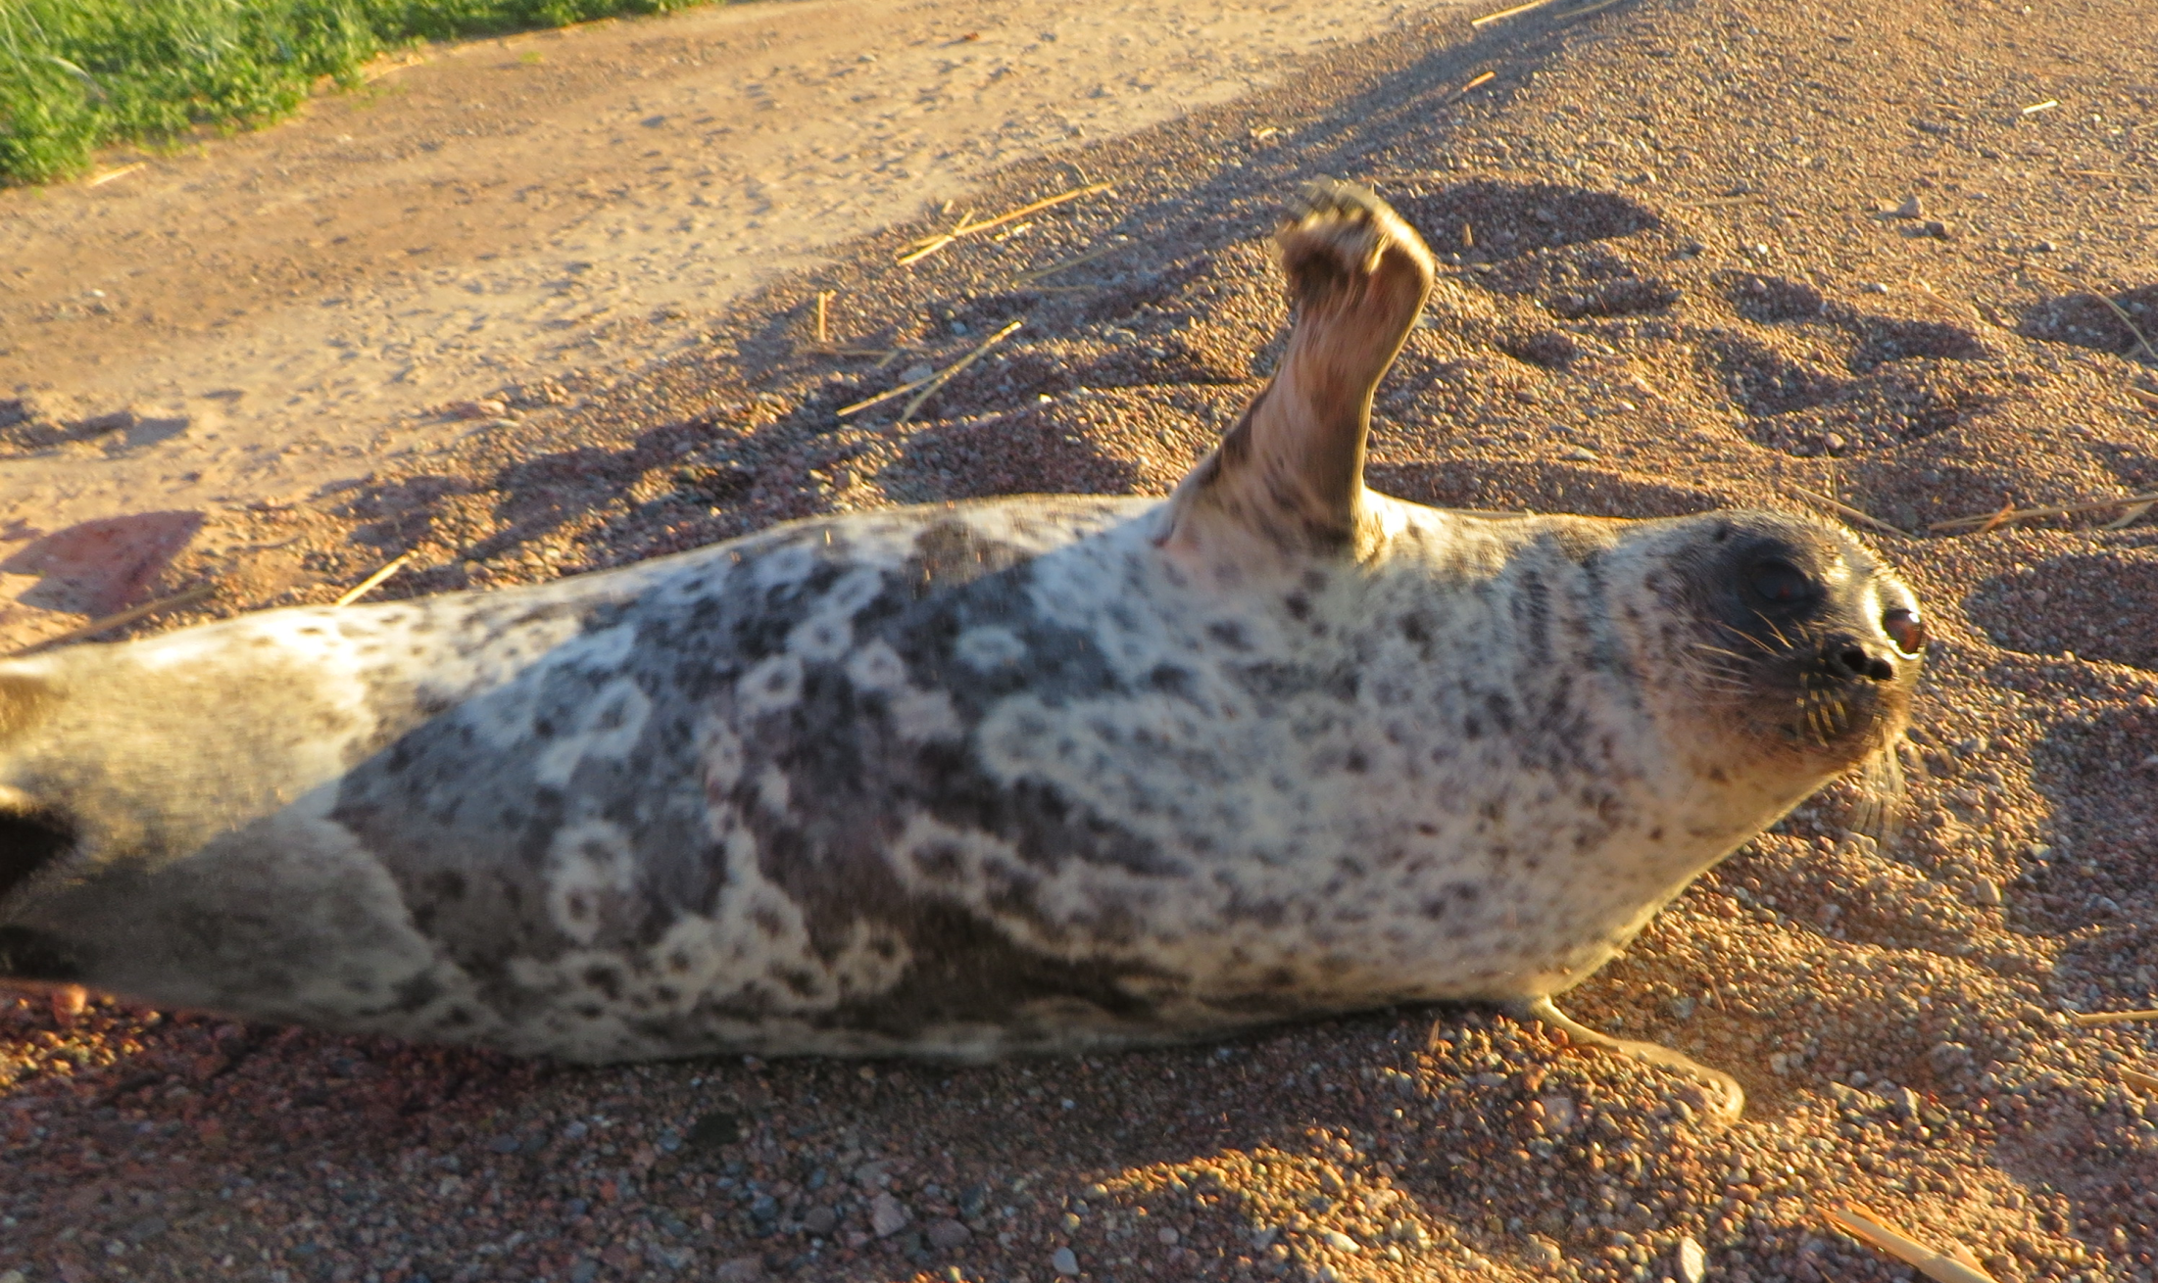
Thank You!

