Slide 1
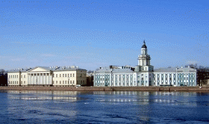
ER55 and additional education
Ksenya Likhacheva and Valentina Kotelnirova
A’REAL studio,
SPBRC RAS, Project Partner-2
ER55 Final seminar
March, 2022

Slide 2
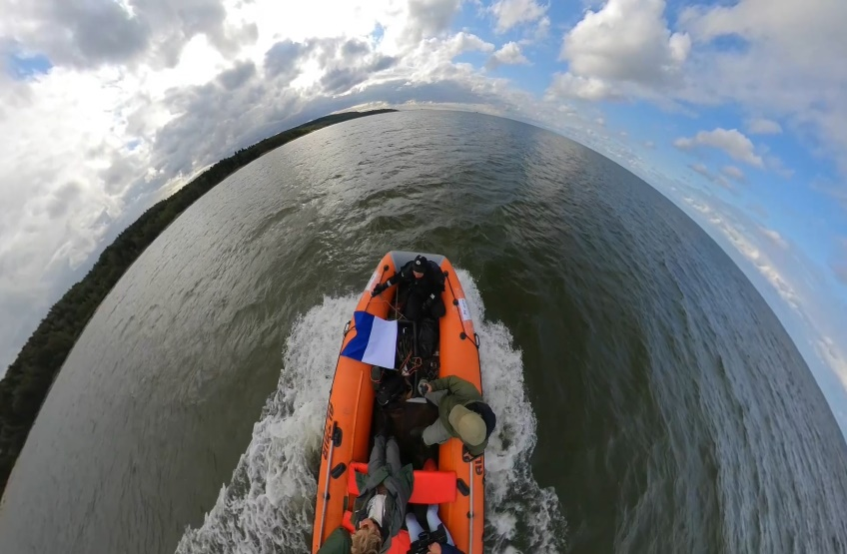
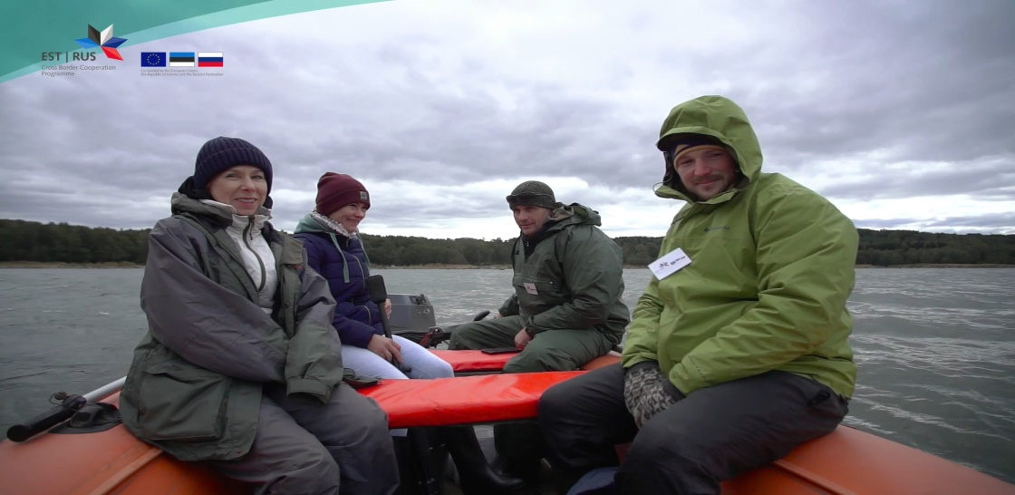
Studio "A'REAL"
Video about ER 55 project
Studio - Production "A`REAL" request by SPBRC RAS created two films about the project of cross-border cooperation between the Russian Federation and the Republic of Estonia.

Slide 3
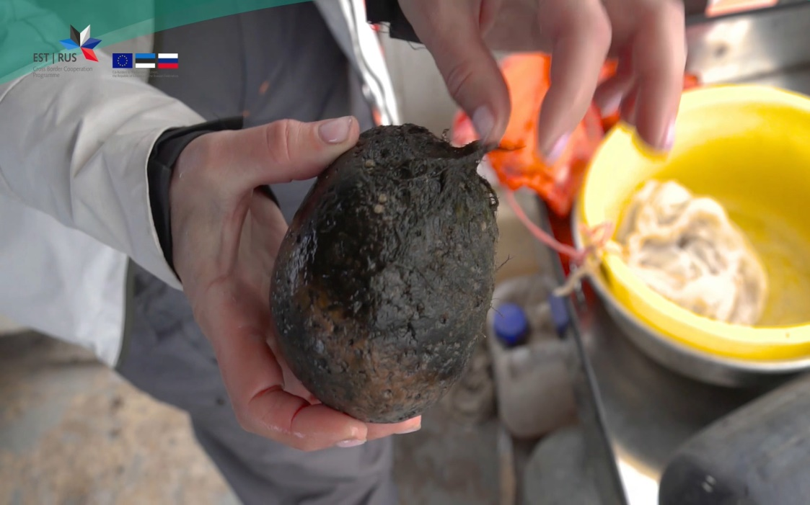
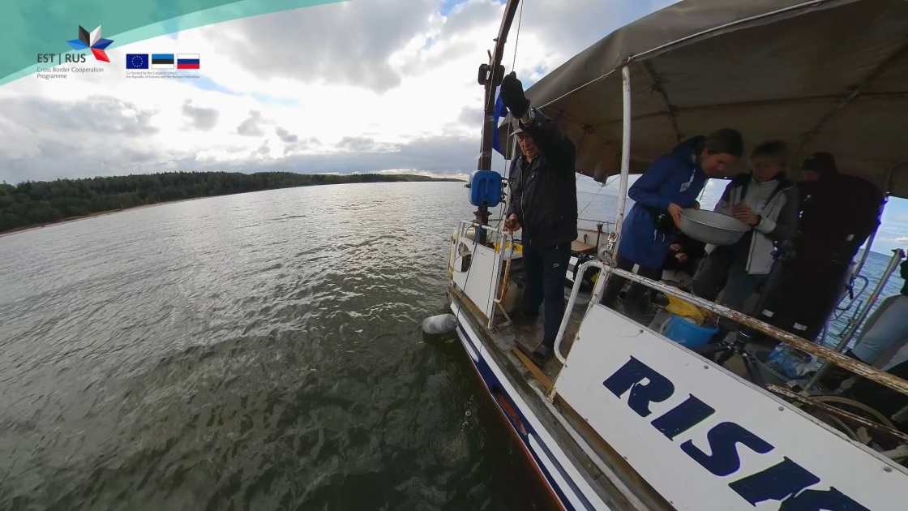
Studio "A'REAL"
Video about ER 55 project
On frames - a plot of Luzhskaya Guba near the village Logi. Observations are underway bottom Invertebrates and their larvae, water vegetation, сoastal fish.

Slide 4
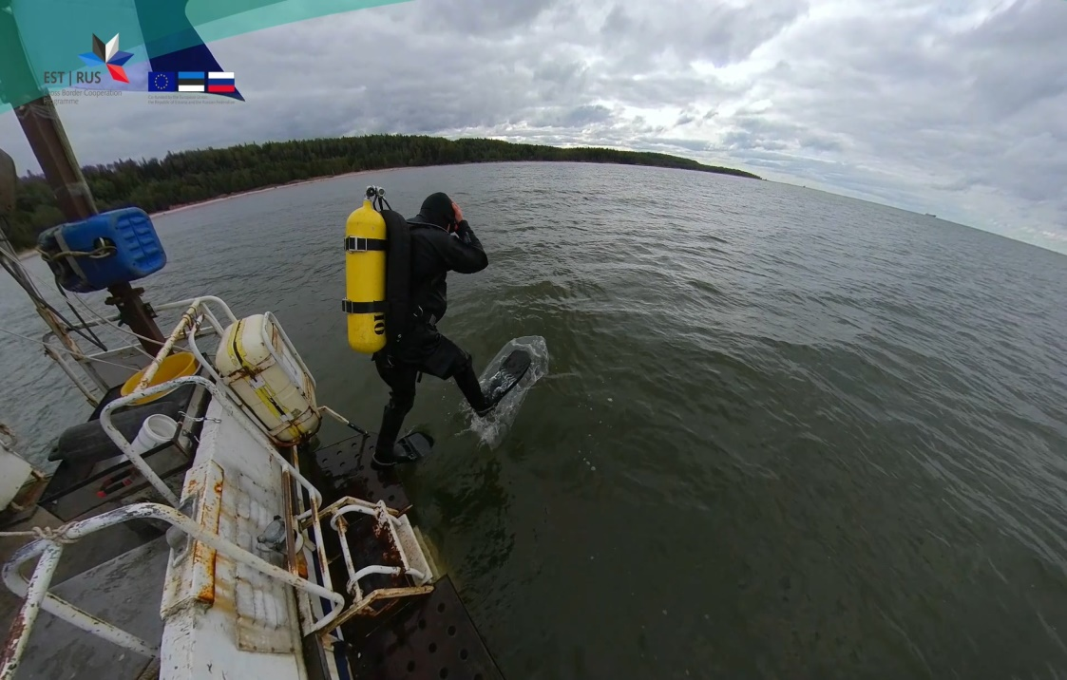
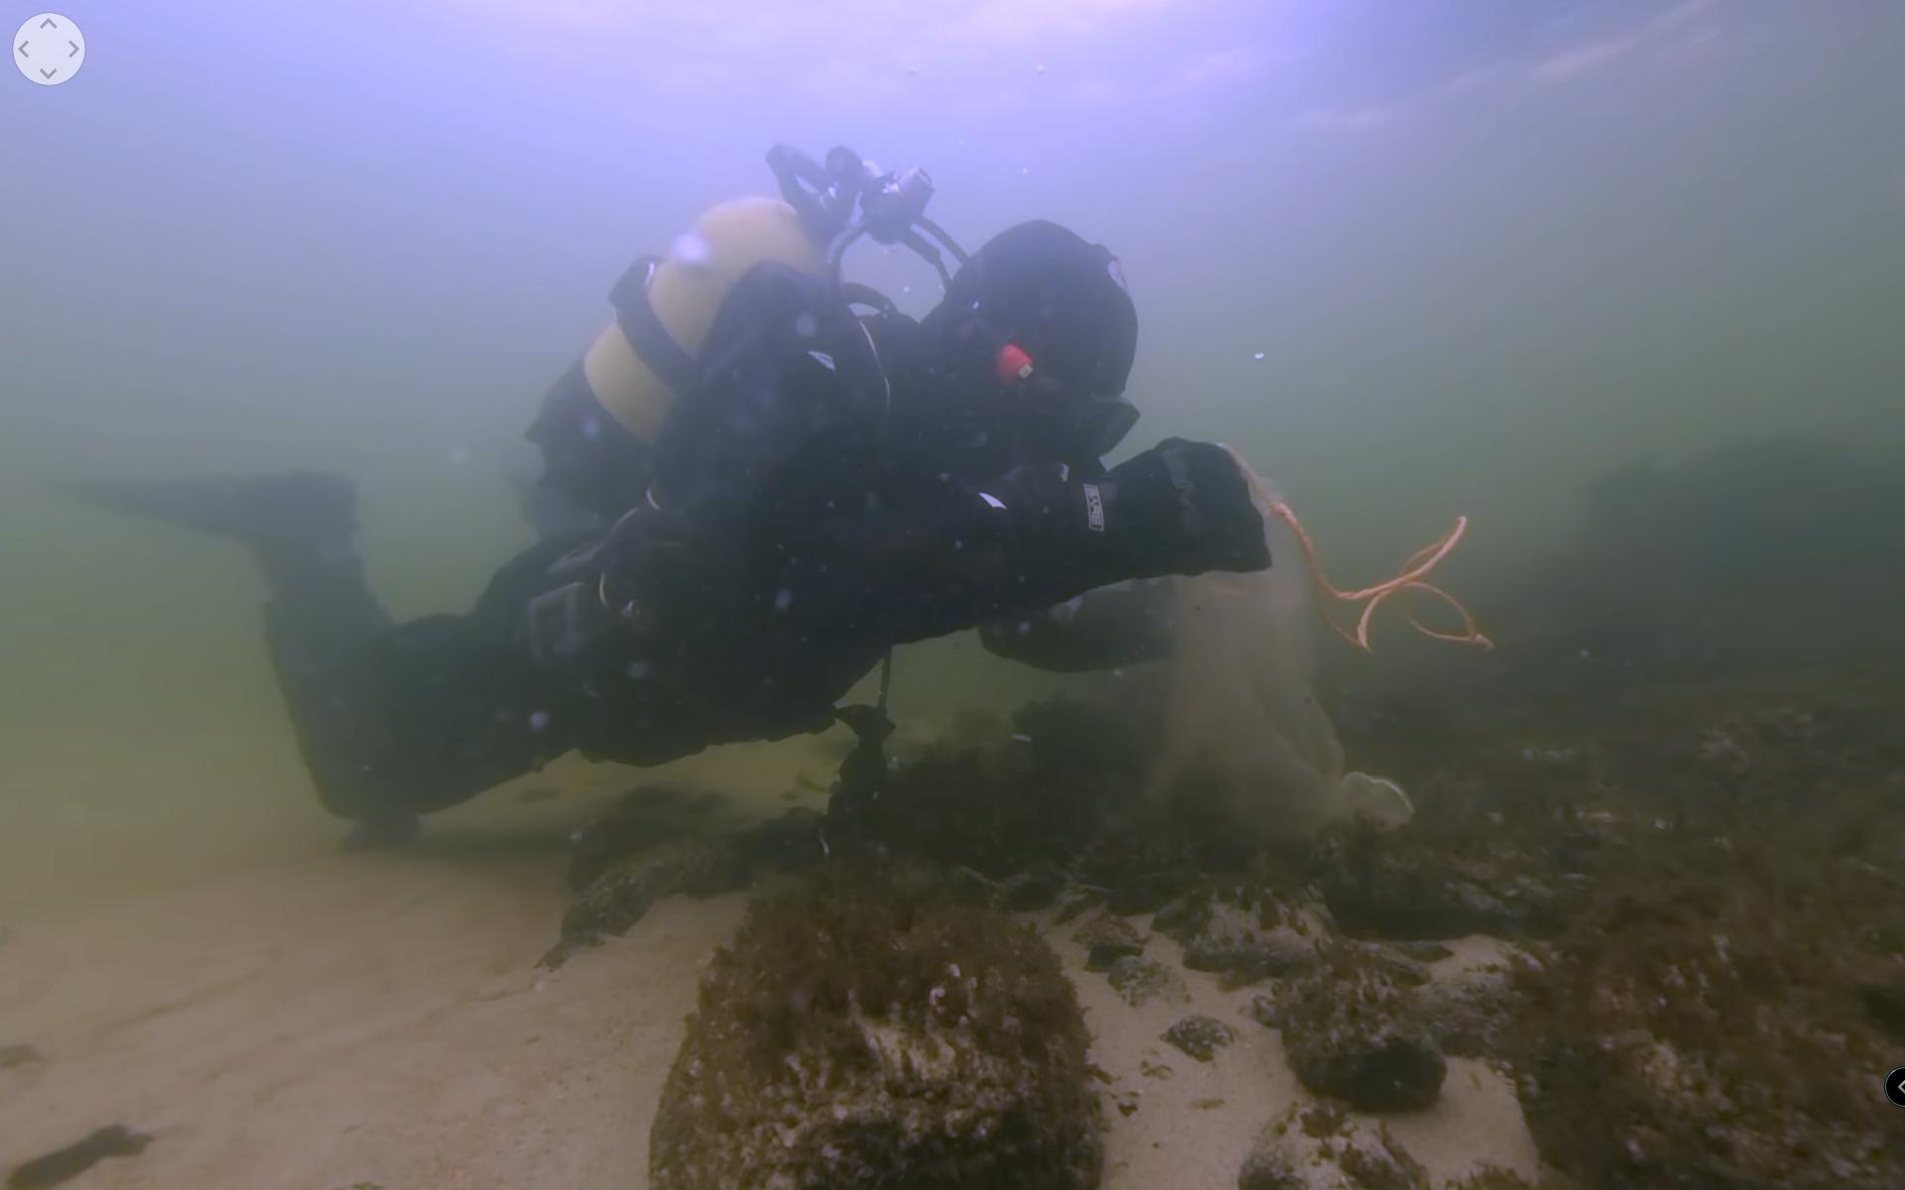
Studio "A'REAL"
Video about ER 55 project
It's frames video 360. Specialized expedition in areas, Indicative in geological and hydrophysical: In the Kaporovskaya and Luzhskaya Guba, Narva Bay.

Slide 5

Studio "A'REAL"
Video about ER 55 project
Studio "A'REAL" has been working in partnership with the Russian Academy of Sciences for more than 20 years. During this time, a deep connection with the academic community, acquired a rich experience in creating research and popular films and educational content.
Films about the project of cross-border cooperation between the Russian Federation and the Republic of Estonia can be used to popularize the results of the project at a very different levels, including educational purposes in specialized educational institutions. Studio "A'REAL" is ready to continue cooperation in this direction.
https://www.youtube.com/user/Arealstudio

Slide 6
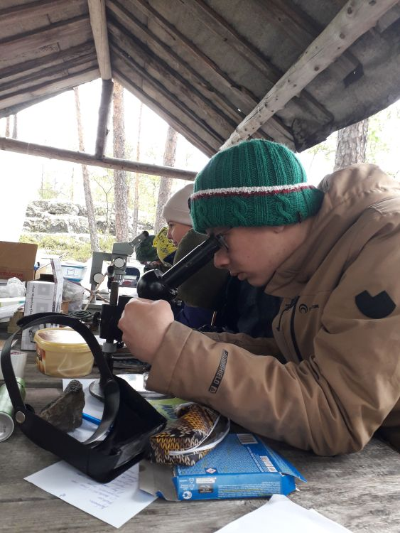
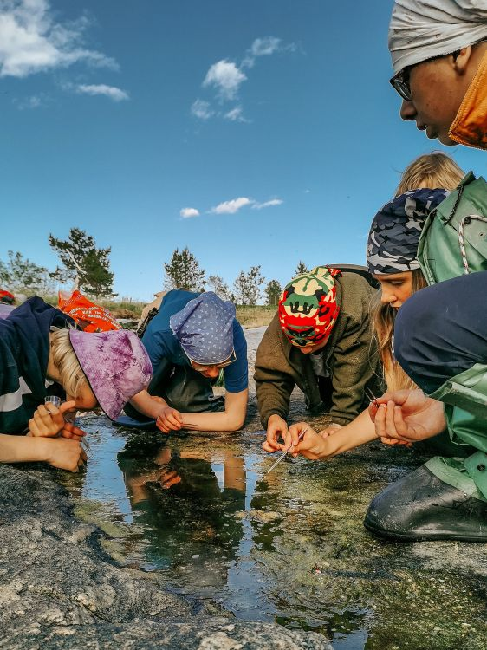


additional education for children
Scientific work on the Gulf of Finland is an important component of the research activities of school children

Slide 7
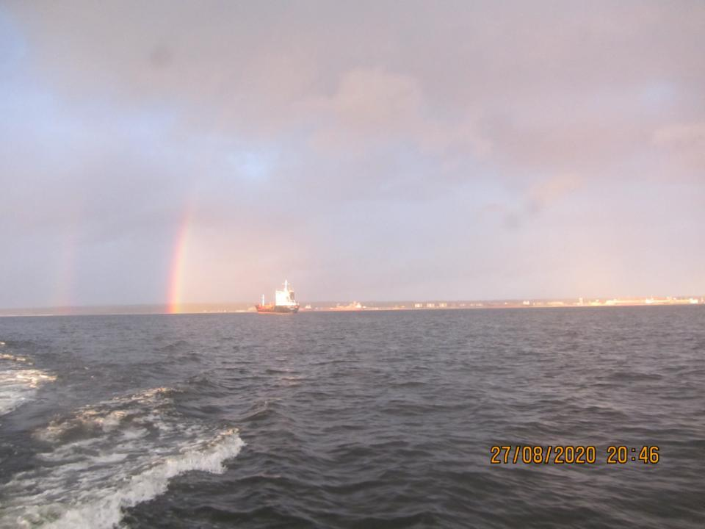
Thank you for your attention!

